Slide 1
Time series shapelets: a new primitive for data mining
报告人：Jorfun

Slide 2
01
解决的问题
02
提出的方法
03
基本概念
CONTENTS
04
寻找shapelet
05
使用shapelet分类
06
方法效果
07
个人想法

Slide 3
01
解决的问题

Slide 4
01
解决的问题
Classification of time series
Recent empirical evidence has strongly suggested that the simple nearest neighbor algorithm is very difficult to beat for most time series problems
Pros
Simple and not requiring extensive parameter tuning
Cons
Requires storing and searching the entire dataset
Beyond mere classification accuracy, we often wish to gain some insight into the data

Slide 5
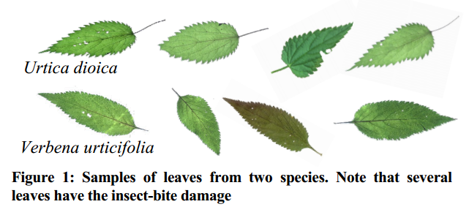
01
解决的问题
Color？Size？ Shape！

Slide 6
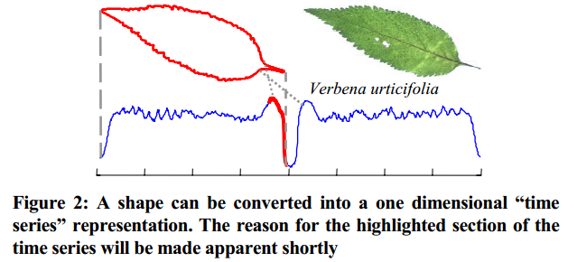
01
解决的问题

Slide 7
01
解决的问题
Using a nearest neighbor classifier with either the (rotation invariant) Euclidean distance or Dynamic Time Warping (DTW) distance does not significantly outperform random guessing. The reason for the poor performance of these otherwise very competitive classifiers seems to be due to the fact that the data is somewhat noisy (i.e. insect bites, and different stem lengths), and this noise is enough to swamp the subtle differences in the shapes.

Slide 8
02
提出的方法

Slide 9
02
提出的方法
Instead of comparing the entire shapes, we only compare a small subsection of the shapes from the two classes that is particularly discriminating. We can call such subsections shapelets.
Shape -> Time series
Subsection of shapes -> Subsequence of time series

Slide 10
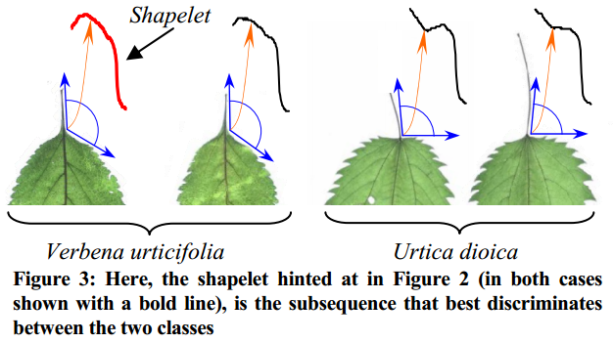
02
提出的方法

Slide 11
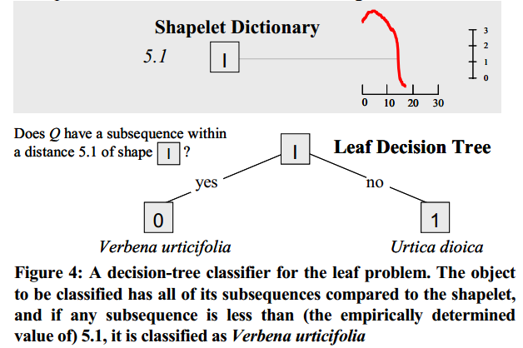
02
提出的方法

Slide 12
02
提出的方法
Pros:
Shapelets can provide interpretable results, which may help domain practitioners better understand their data.
Shapelets can be significantly more accurate/robust on some datasets.
Shapelets can be significantly faster at classification than existing state-of-the-art approaches.

Slide 13
03
基本概念

Slide 14
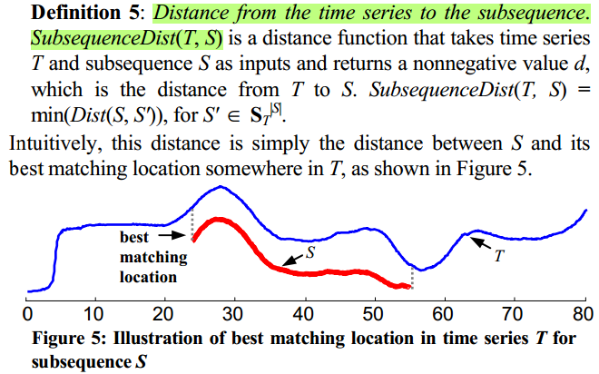
03
基本概念：一段完整时间序列与一段子序列的距离
Notes:
The shapelet is a subsequence of a time series such that most of the time series objects in one class of the dataset are close to the shapelet under SubsequenceDist, while most of the time series objects from the other class are far away from it.

Slide 15
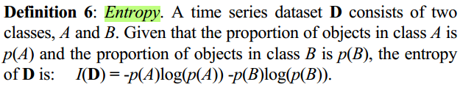
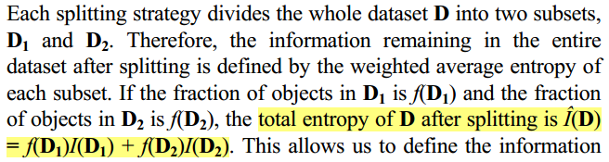
03
基本概念：熵
对数据集怎样划分（分类）才是好的划分？需要一个度量指标
Entropy表示随机变量不确定性的度量

Slide 16
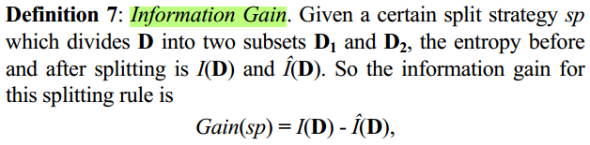
03
基本概念：信息收益
Information gain: 由于当前特征而使得对数据集D的分类的不确定性减少的程度
用信息收益（数据集被划分前后熵的差值）来衡量分类情况的好坏

Slide 17
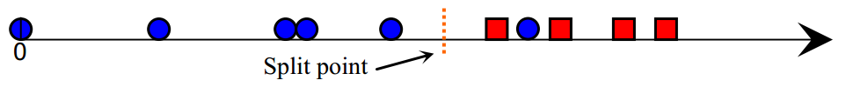
03
基本概念：候选shapelet
To find the best shapelet, we may have to test many shapelet candidates. given a candidate shapelet, we calculate the distance between the candidate and every time series object in the dataset. We sort the objects according to the distances and find an optimal split point between two neighboring distances.

Slide 18
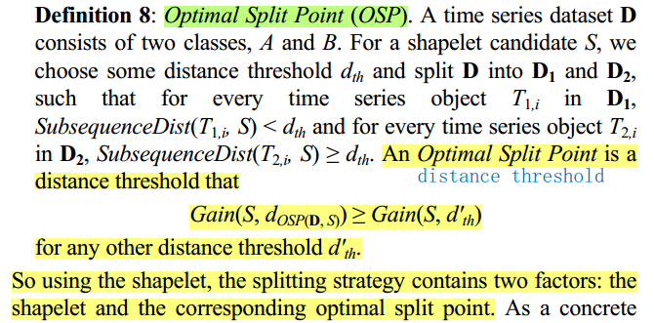
03
基本概念：候选shapelet的最优划分点

Slide 19
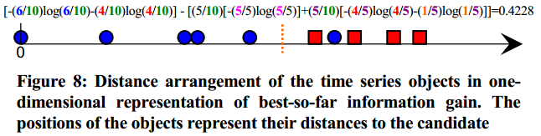
03
基本概念：候选shapelet的最优划分点

Slide 20
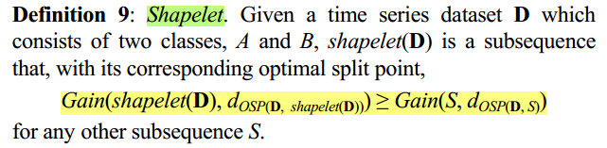
03
基本概念：Shapelet
Shapelet: 一个候选shapelet，当使用与其对应的最优划分点来划分数据集时，能够获得最好的信息收益

Slide 21
04
寻找shapelet

Slide 22
04
寻找shapelet的思路

Slide 23
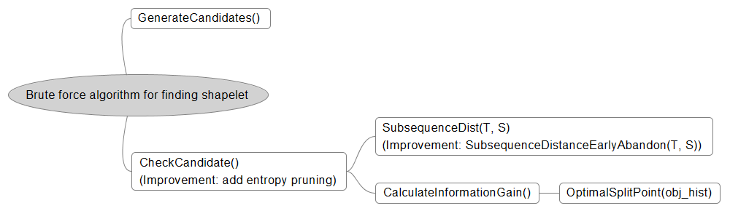
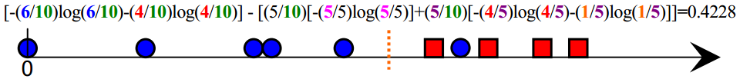
04
用于寻找shapelet的算法

Slide 24
04
Improvement: Subsequence Distance Early Abandon
给定一个shapelet候选项S，计算它与一个时间序列T的距离。如果遍历T的subsequence并计算该距离的过程中发现距离值已经超过min_dist了，那么就没必要计算了，因为我们要的是最小的min_dist值。

Slide 25
04
Improvement: Admissible Entropy Pruning
We adopted the entropy evaluation for two reasons.
First, it is easily generalized to the multi-class problem.
Second, we can use a novel idea called early entropy pruning to avoid a large fraction of distance calculations required when finding the shapelet.

Slide 26
04
Improvement: Admissible Entropy Pruning
Obtaining the distance between a candidate and its nearest matching subsequence of each of the objects in the dataset is the most expensive calculation in the brute force algorithm, whereas the information gain calculation takes an inconsequential amount of time.
Based on this observation, instead of waiting until we have all of the distances from each of the time series objects to the candidate, we can calculate an upper bound of the information gain based on the currently observed distances. If at any point during the search the upper bound cannot beat the best-so-far information gain, we stop the distance calculations and prune that particular candidate from consideration, secure in the knowledge that it cannot be a better candidate than the current best so far.

Slide 27
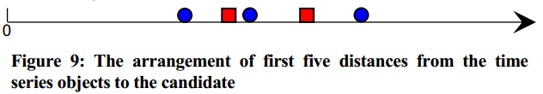
04
Improvement: Admissible Entropy Pruning
对于某个shapelet candidate，我们已经计算了X个时间序列对象与它的距离。此时我们可以开始预测最终计算完所有距离时，可能出现的information gain最好情况，然后将其与best_so_far的information gain进行比较，决定是否继续计算该candidate与数据集中剩余时间序列的距离。

Slide 28
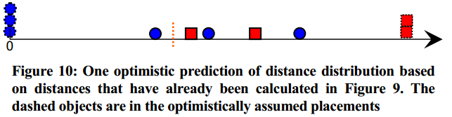
04
Improvement: Admissible Entropy Pruning
There are only two optimistic possibilities: either all of the remaining class A objects map to the far right and all of the class B objects map to the far left, or vice versa.

Slide 29
05
使用shapelet分类

Slide 30
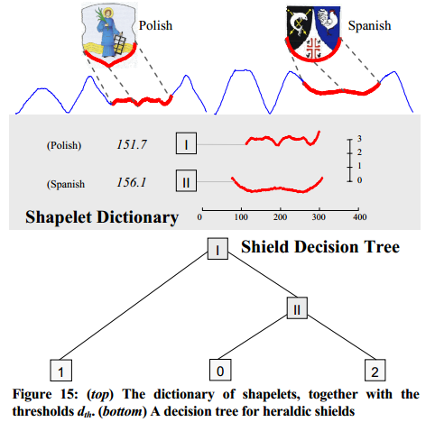
05
使用shapelet分类

Slide 31
06
方法效果

Slide 32
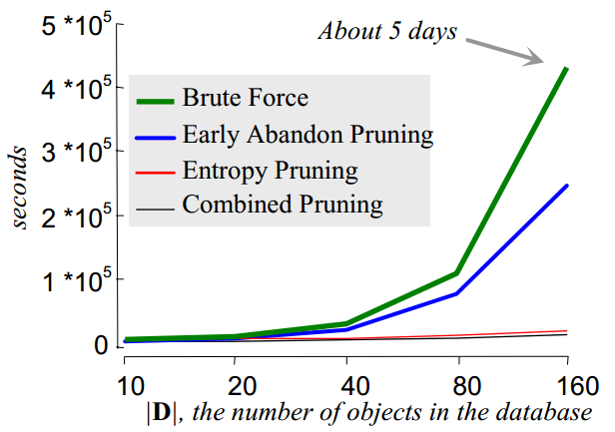
06
Using four different search algorithm to find the shapelet
Synthetic Lightning EMP Classification, a 2,000/18,000 train/test split, with
each time series object being 2,000 data points long

Slide 33
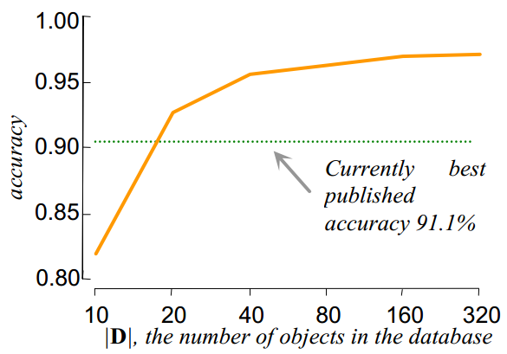
06
Using four different search algorithm to find the shapelet
For each size data subset we considered, we also built a decision tree and tested the accuracy on the 18,000 holdout data.

Slide 34
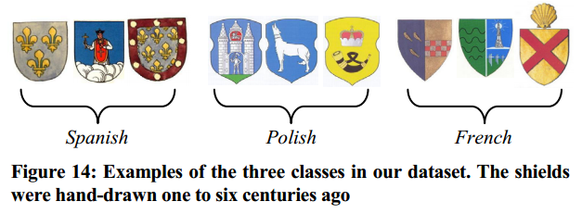
06
Mining Historical Documents

Slide 35
06
Mining Historical Documents

Slide 36
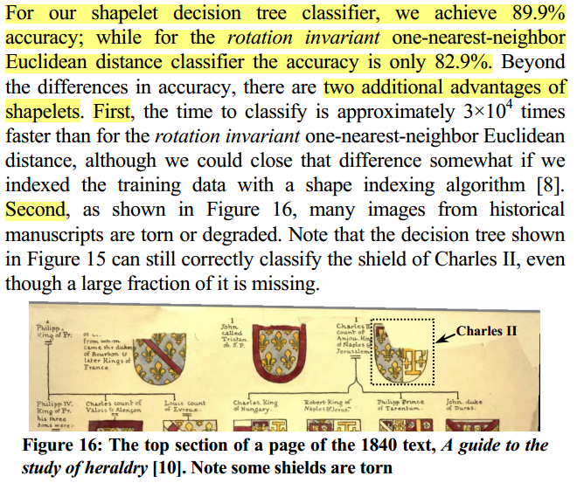
06
Mining Historical Documents

Slide 37
07
个人想法

Slide 38
07
个人想法
在确定最终shapelet的过程中，对于每个候选shapelet，寻找最优划分点的花费会不会很大？因为需要尝试各种可能的位置。Shapelet分类与KNN分类的适用情况？
实验对比的对象：rotation invariant one-nearest-neighbor classifier. 是Brute Force的形式？还是有所优化的版本？
时间序列的关键区分部分如果有噪声那也会出现问题。
用shapelet来做时间序列的异常检测？类别不平衡的问题怎么办？
监督式学习，训练数据需要有标签，给心率序列标上是否异常的标签？

Slide 39
感谢聆听

